Slide 1
The Story of Seismic-Build-Webpack-Plugin
Feb13,2019
Byron Xu

Slide 2
StoryLine
Why do we need a webpack plug-in
What is the Seismic-Build-Webpack-Plugin
How to develop Seismic-Build-Webpack-Plugin

Slide 3
Why do we need a webpack plug-in
About the new cicd solution
The Manifest.json file
Asynchronous loading of seismic package in new cicd
Others

Slide 4
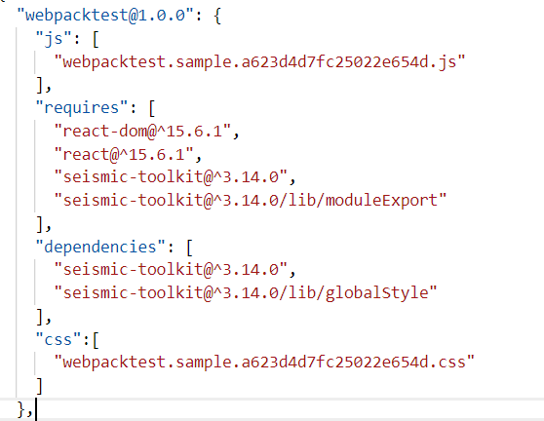
The manifest.json file

Slide 5
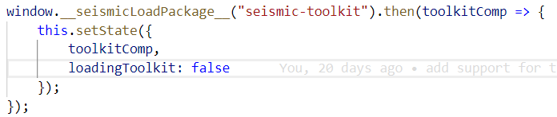
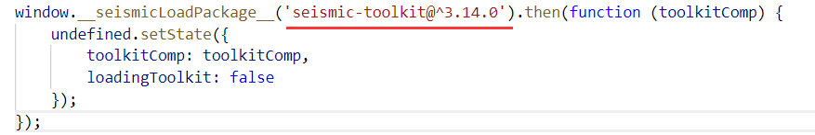
Asynchronous loading of seismic package

Slide 6
What is the Seismic-Build-Webpack-Plugin
About the new cicd solution, it contains three stages: generation, development and runtime. The plug-in is responsible for generation stage.
This plug-in is a set of functions, See https://bitbucket.org/seismicsoftware/seismic-build-webpack-plugin

Slide 7
How to develop Seismic-Build-Webpack-Plugin
The webpack mechanism
Development of a plug-in
The plug-in debugging and test
Development of seismic-build-webpack-plugin
Integration of multiple plug-ins
About common libraries extraction
About webpack version

Slide 8
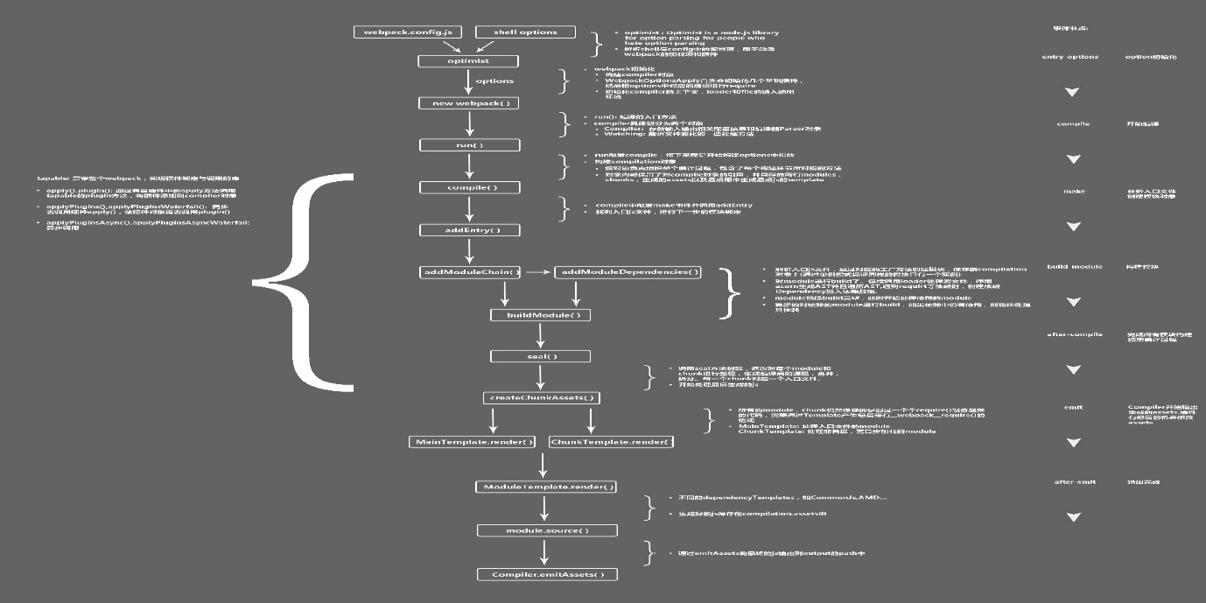
The webpack mechanism
The event flow framework: tapable
https://github.com/webpack/tapable
https://www.jianshu.com/p/c71393db6287
Webpack events flow
https://www.webpackjs.com/plugins/
https://img.alicdn.com/tps/TB1GVGFNXXXXXaTapXXXXXXXXXX-4436-4244.jpg

Slide 9
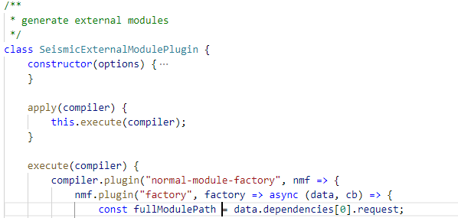
Development of a plug-in
Define the apply method
Bind event methods

Slide 10

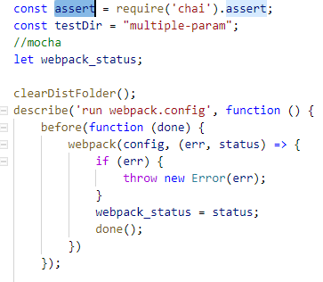
The plug-in debugging and test
Initially, we wanted to debug plug-ins in the jest, but it did not work. The reason is that the jest will intercept the require method and cause packages to fail to load. So for debugging, we can start the test script directly with no test framework. For test , we can use mocha test framework, it worked well.

Slide 11
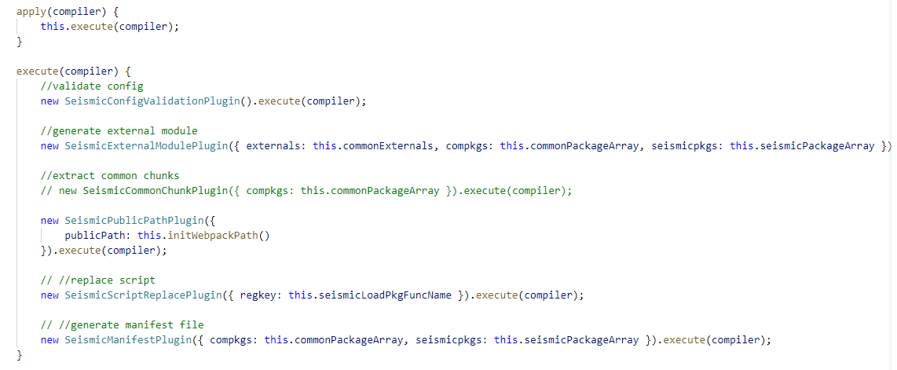
Integration of multiple plug-ins
Define a integration plugin
Define the apply method
Pass the compiler parameter to multiple plug-ins

Slide 12
About common libraries extraction
About the common libraries extraction issue, it‘s a long topic. We must know some core concepts and objects in webpack, for example compilation,compilation entryPoints, chunk, entryChunk, ,chunk parent, chunk groups, module, entryModule, kinds of dependencies, runtime and so on. Throughout the plug-in development process, we spent most of our time on it, and crossed unknowns one after another. I will try to share some experiences
How to know webpack core concepts and objects.
Find related documents
View other plug-in source code
Debug plug-in
View webpack source code
About npm link
About webpack package processing mechanism
About react and react-dom (v15 & v16) in webpack

Slide 13
Chunk component logic diagram
Runtime
Entry Module
Normal Module
External Module
Polyfill Module

Slide 14
Webpack package dependence standard
Chunk 1
Entry Module
Module A
Module B
Module C
Chunk 2
Entry Module
Module L
Module M
Module N

Slide 15
React & React-Dom(v15)
React Chunk
Entry Module
Module A
Module B
Module C
Expected React-Dom chunk
Entry Module
Module L
Module M
Module N
Actual React-Dom chunk
Entry Module
Module L
Module M
Module N
Module A
Module B
Module C

Slide 16
About webpack version
For now, the plug-in just supports webpack3, the reason is that chunk.parents used in plug-in is not supported in webpack 4, in future we can use chunkGroups in higher webpack version.

Slide 17
Thanks!

